Slide 1
Just Tanned
Mr. Hrushikesh Kuklare, (Roll No. 181080041), SY(IT)
Mr. Rishab Munot, (Roll No. 181080053), SY(IT)
Mr. Pratik Jain, (Roll No. 181080050), SY(IT)
Mentors: Dr V B Nikam, Prof Mayuri More
Department of Computer Engg & IT

Slide 2
Problem Statement
Make a user-friendly application that can be used by the Leather stores in Dharavi to enlist their products and sell them via an e-commerce portal. It will also help to manage the stocks in the shop. It will help store transactional data between sellers and buyers and also help them to reach out to new customers. Which will enhance their sales.

Slide 3
Features Included
Signing up new users by accepting their profile (email, name, password, date of birth and mobile no.).
Login Authentication of the users.
Authenticating users using Json Web Tokens.
Providing customers a various variety of products to choose from
Providing customers with a great description of products.
Customers can add products to the cart.

Slide 4
Customers can delete products from the cart.
Customers can instantly buy products by clicking Buy Now button.
Providing a powerful sort and filter tool feature to browse products on there choice and also in there price range.
Providing a great checkout experience.
Providing functionality to add and delete address.
Customers can save multiple address and choose one to be default.
Providing different options for payments like Cash on Delivery, debit card, credit card, upi, etc.

Slide 5
Tools used
React.js as basic client side rendering framework
Node.js to communicate between database and client.
Postgresql for storing data.
Heroku for hosting of Api.
Firebase Hosting as Web Hosting.
Github actions for Continuous Development and Continuous Integration.

Slide 6
React
React also know as (React.js) is an open source Javascript library for building user interfaces.
It is maintained and developed by Facebook and a community of individual developers and companies.
React can be used as a base for a single page application. It is only concerned with rendering data to virtual DOM.

Slide 7
Node.js
Node.js (Node) is an open source development platform for executing JavaScript code server-side.
Node is useful for developing applications that require a persistent connection from the browser to the server and is often used for real-time applications such as chat, news feeds and web push notifications.

Slide 8
Postgresql
PostgreSQL is a general purpose and object-relational database management system, the most advanced open source database system. It is a sql based language.
It is aimed to store, manipulate, and query data stored in relational databases. We used such queries to insert the user and message data into the database and extract it show on client side of the website.

Slide 9
Node modules used
Pg - It is used for connecting the website with postgresql database.
Express- It is used for routing.
Body-parser - It acts as a middleware for getting contents from frontend
Bcrypt – It is used to encrypt and check passwords .
jsonwebtoken – It is used for creating and verify Json Web Tokens.
cors – To allow request to the servers from a specific url.
dotenv – To encrypt the server details and passwords.
razorpay - To integrate payment gateway in our website.

Slide 10
ER Diagram

Slide 11
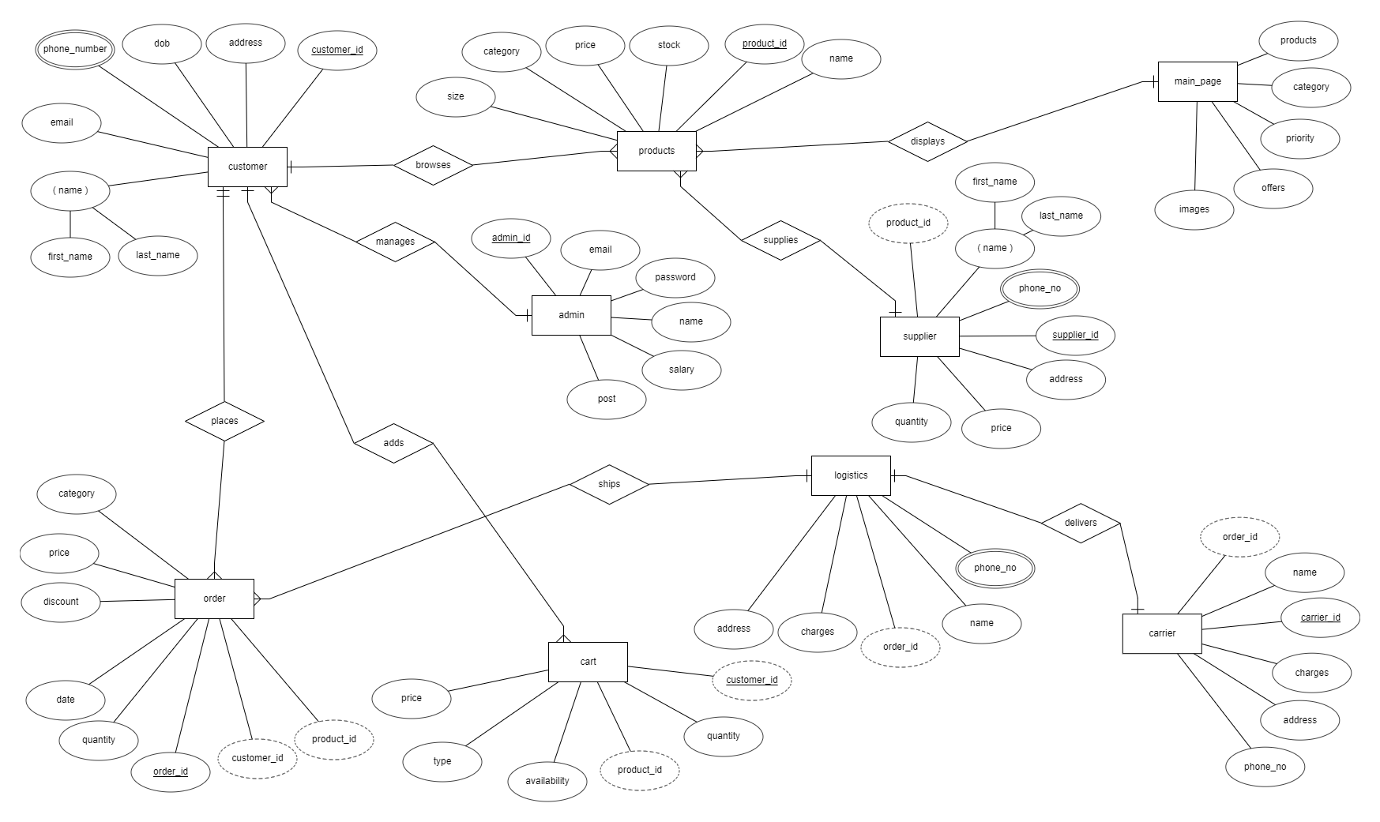

Slide 12
Schema Design

Slide 13
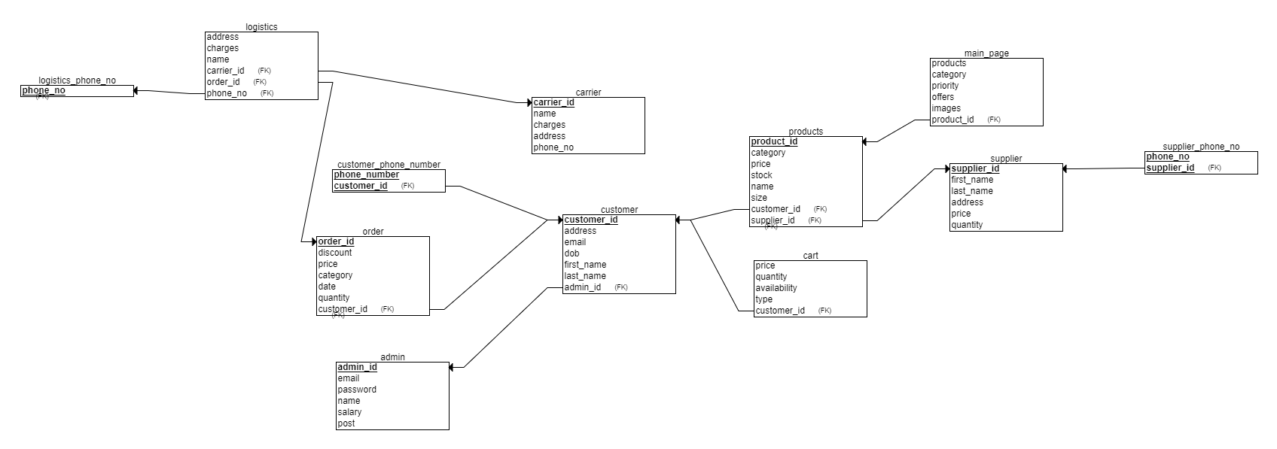

Slide 14
Data Dictionary

Slide 15
Users Table
Table | Column | Data Type | References | Default | Not Null
users | user_id | bigint |  |  | t
 | name | text |  |  | t
 | email | varchar(150) |  |  | t
 | password | text |  |  | t
 | mobile | numeric |  |  | t
 | dob | text |  |  | t
 | latitude | numeric
 | longitude | numeric
 | address_list | text[]
 | default_address | int

Slide 16
Products Table
Table | Column | Data Type | References | Default | Not Null
products | product_id | bigint |  |  | t
 | title | text |  |  | t
 | description | text |  |  | t
 | stock | int |  |  | t
 | in_stock | boolean |  |  | t
 | price | int |  |  | t
 | discounted_price | int
 | discount | int
 | product_images | text[]
 | labels | text[]
 | values | text[]
 | category1 | text
 | category2 | text
 | category3 | text

Slide 17
Categories Table
Table | Column | Data Type | References | Default | Not Null
categories | category1 | text[]
 | category2 | text |  |  | t
 | category3 | text[]

Slide 18
Cart Table
Table | Column | Data Type | References | Default | Not Null
cart | user_id | bigint | users(user_id) |  | t
 | product_id | bigint | products(product_id) |  | t
 | count | int |  |  | t

Slide 19
Orders Table
Table | Column | Data Type | References | Default | Not Null
orders | order_id | bigint |  |  | t
 | product_id | bigint | products(product_id) |  | t
 | user_id | bigint | users(user_id) |  | t

Slide 20
Order Details Table
Table | Column | Data Type | References | Default | Not Null
order_details | order_id | bigint | orders(order_id) |  | t
 | delivery_at | text |  |  | t
 | payment_method | text |  |  | t
 | amount | int |  |  | t
 | status | text |  |  | t

Slide 21
Unique Keys
Type | Table | Key | Columns
primary | users | users_pkey | user_id
unique | users | email_unique_key | email
primary | products | products_pkey | product_id
primary | cart | cart_pkey | (user_id, product_id)
primary | orders | orders_pkey | (Order_id, product_id)
primary | order_details | order_details_pkey | order_id

Slide 22
Foreign Keys
Key | Table | Columns | Ref Table | Ref Column
cart_productid_fkey | cart | product_id | products | product_id
cart_userid_fkey | cart | user_id | users | user_id
orders_productid_fkey | orders | product_id | products | product_id
orders_userid_fkey | orders | user_id | users | user_id

Slide 23
Home page
The home page has a Navbar and a list of products
In home page itself the products are categorized by their main types like Jackets, Bags, Wallets, etc.
It show four products of each category.
If you want to view more products then just click the View All button which is on the right-most side of the category heading.

Slide 24
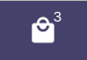
Navbar
The navbar contains Home, Login, Sign up, and a bag option.
The Bag Icon has a badge on it which shows the total number of items present in the Bag.

Slide 25
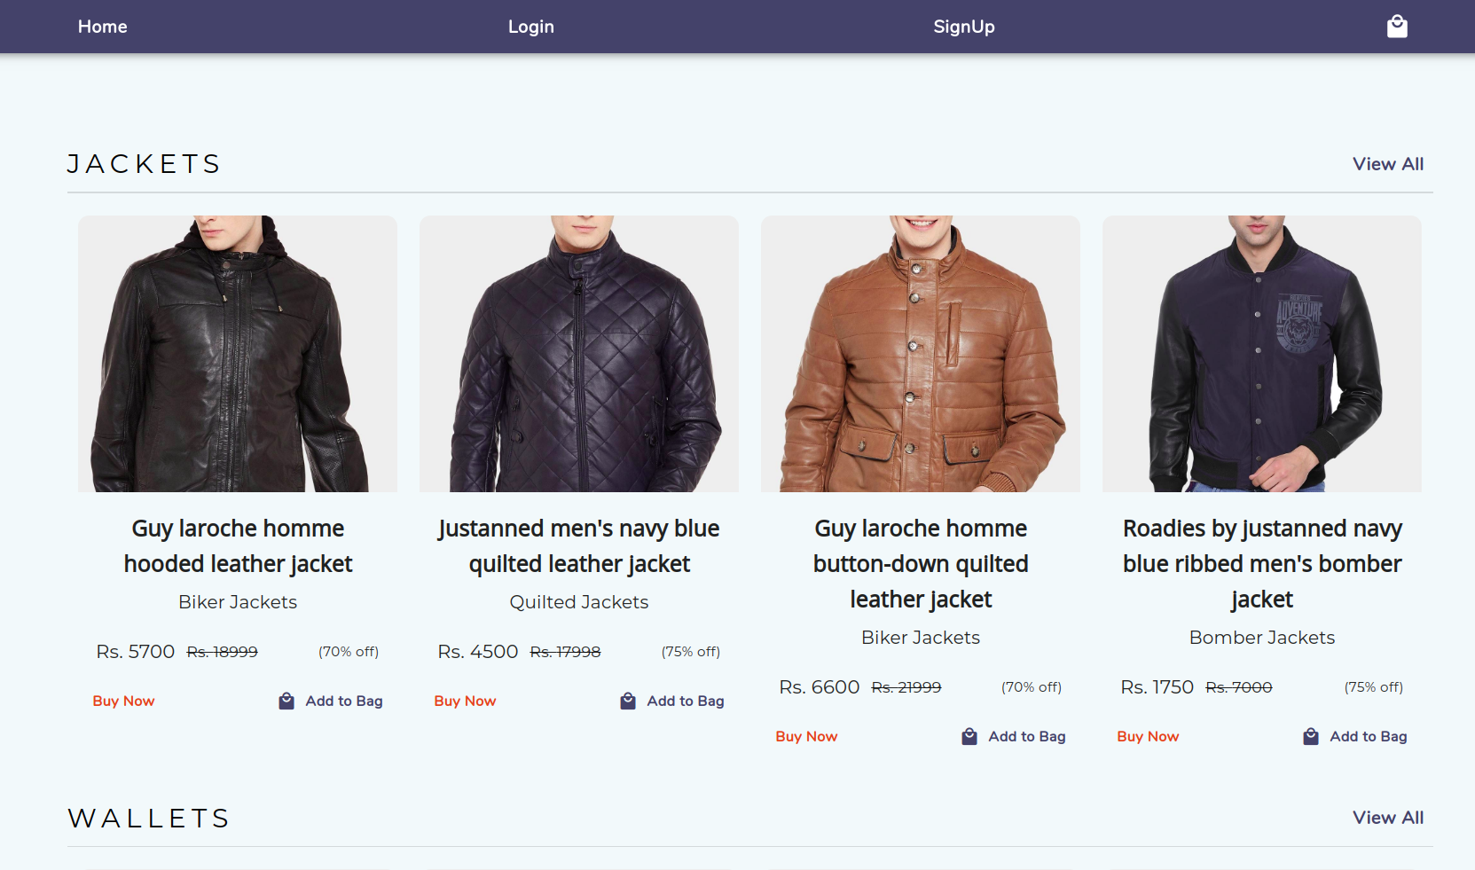

Slide 26
Sign Up Page
The sign up page contains the fields which should be filled to complete the profile of the user before he/she starts using our services.
This will include the name, email, password, date of birth and mobile no. which the customer will upload. This information will be added in the database from here.

Slide 27
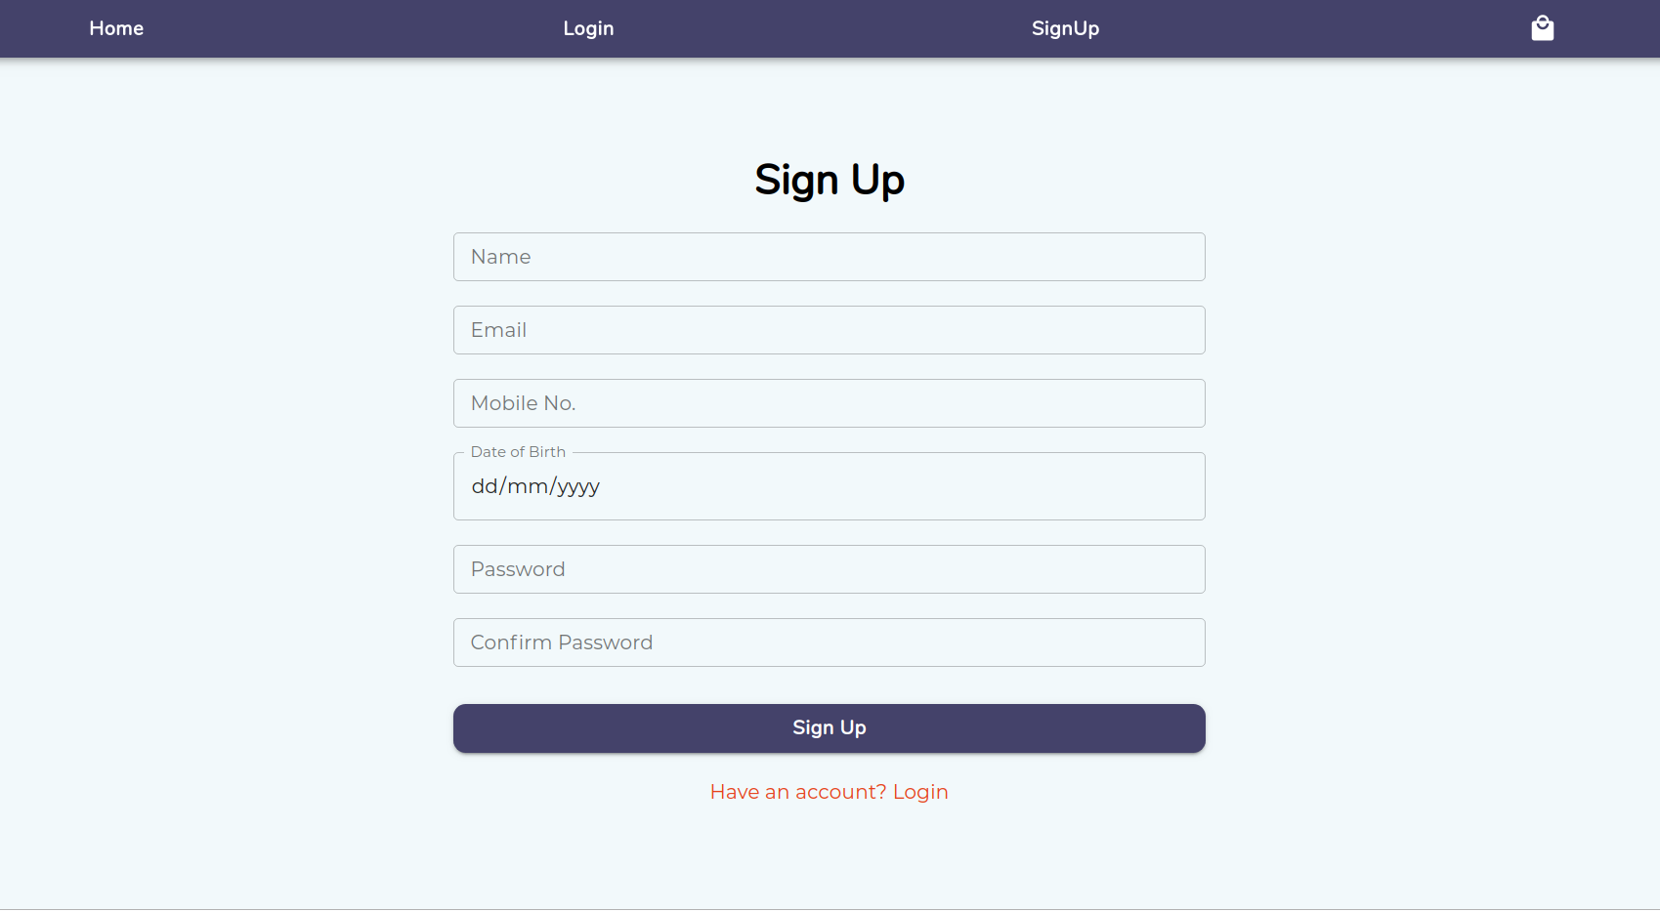

Slide 28
Login Page
So if you are already have an account then the Login Page appears.
Here he/she can enter the email and password where it is authenticated from the database contents which were entered in the database from the sign up page.
If the email and password are not correct the user will be redirected to the login page again with the errors he made and iff it is correct he will be redirected to the home page.

Slide 29
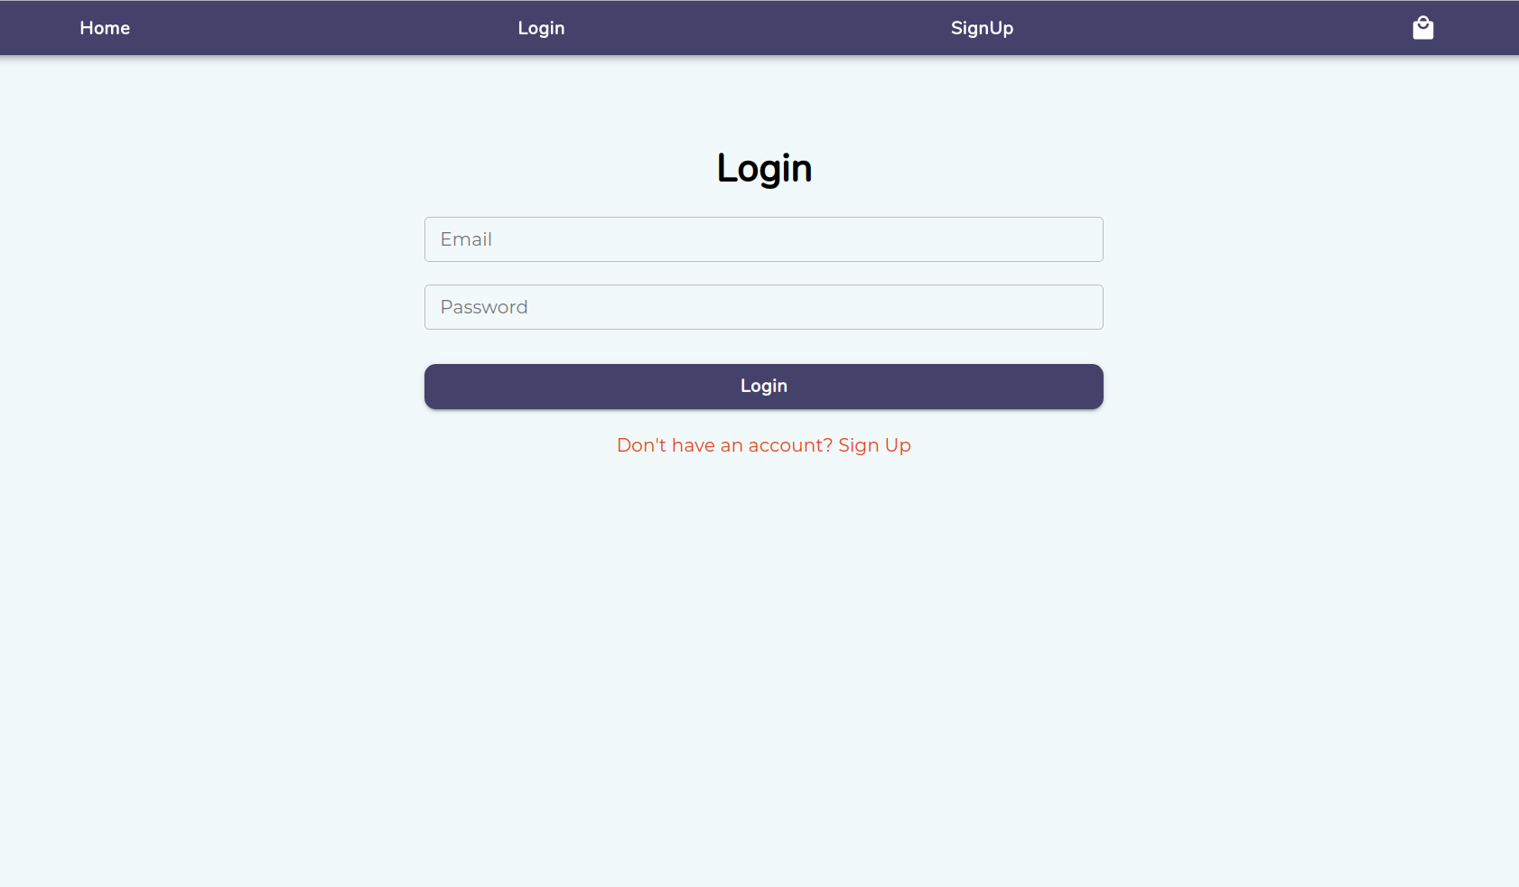

Slide 30
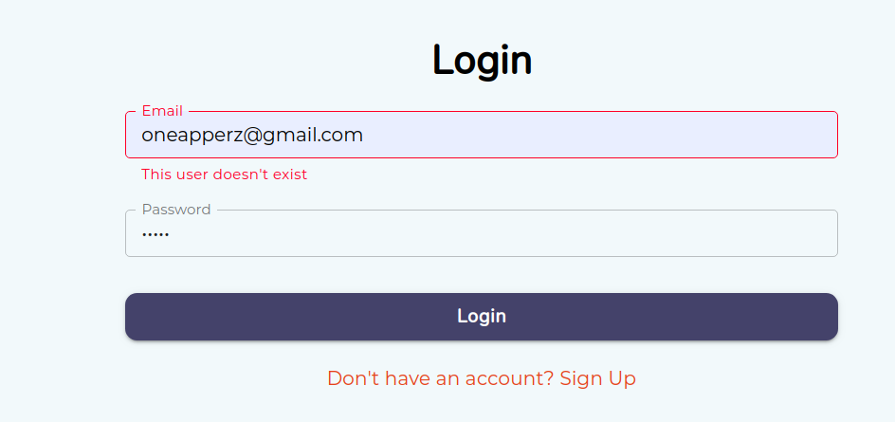
If you enter wrong credentials you get the errors like this

Slide 31
View All Products
If you click the button from view all from home page then you are redirected to view all products page.
Here you can view all of our products.
We have paginated this page so that we don’t make unnecessary calls to our database get a lots of data.
As you scroll down you we will get loader till you get more products from the database.

Slide 32
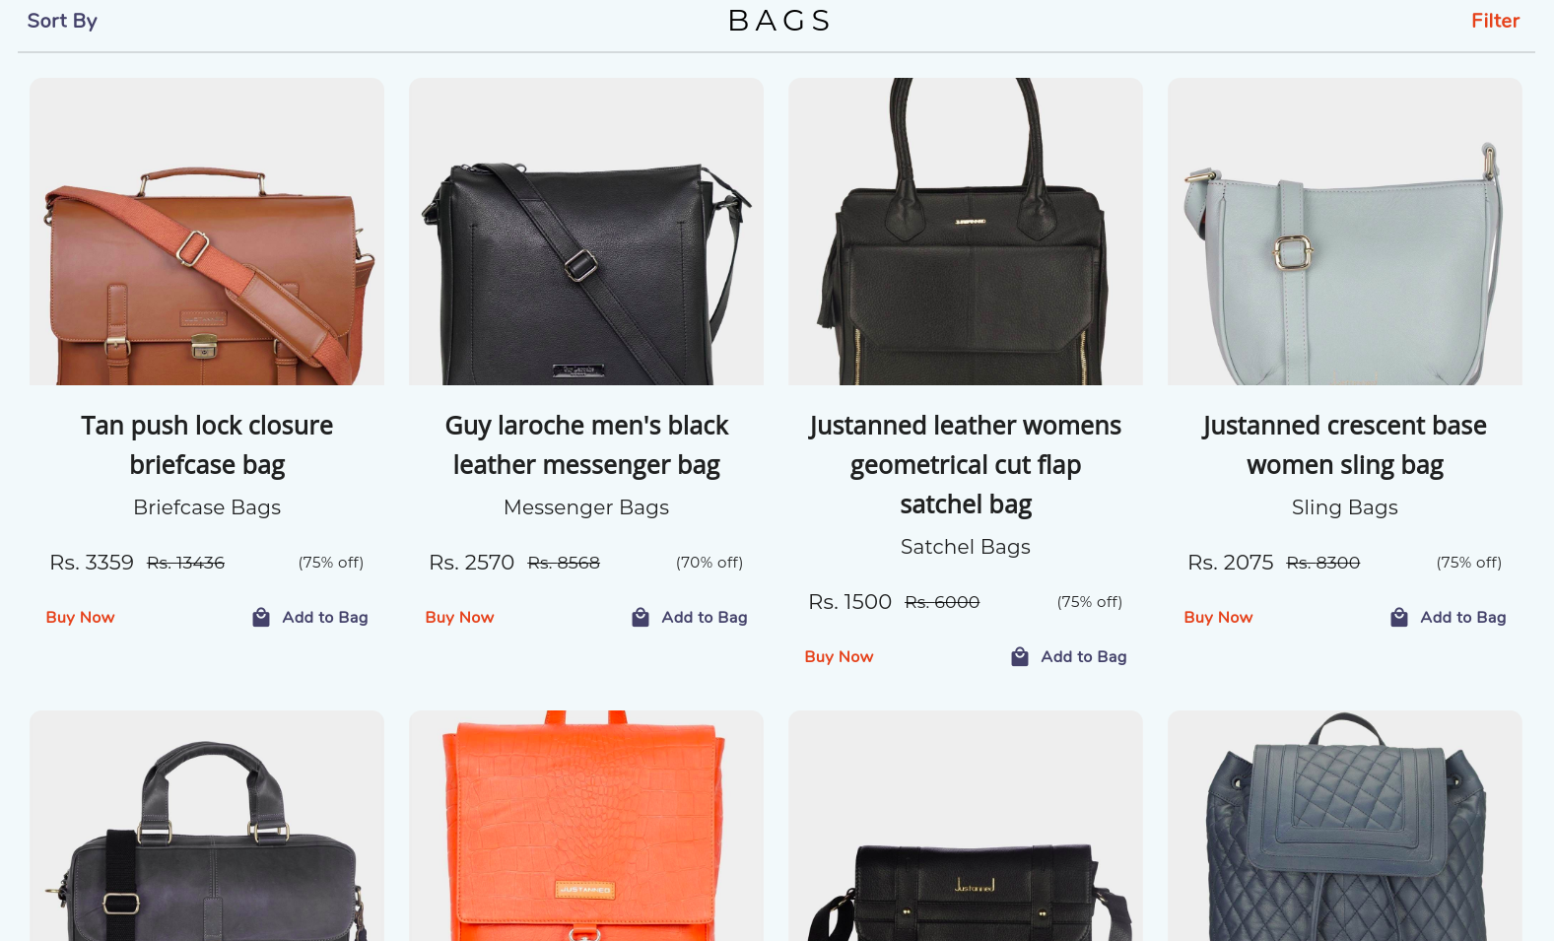

Slide 33
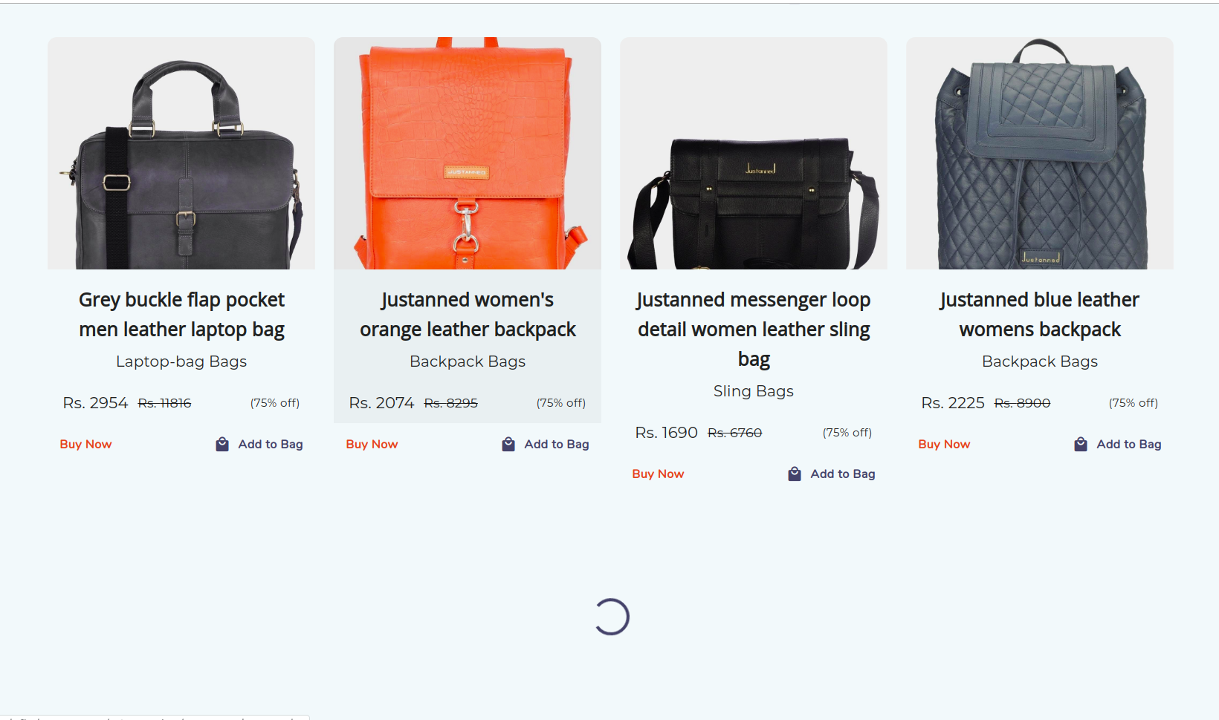
Paginating Data

Slide 34
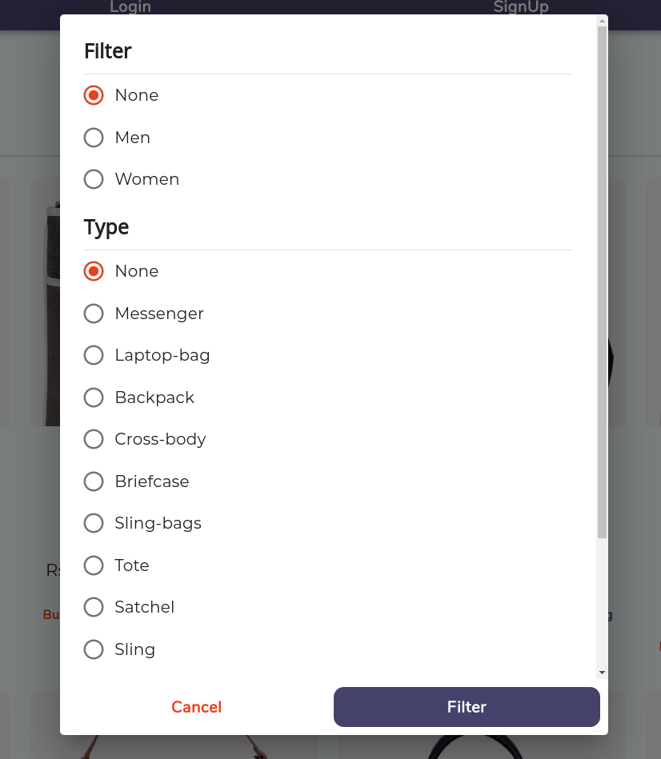
This page comes with powerful sorting and filtering techniques.
As you click on filter you will get the popup asking for you to select the filter you want to apply.

Slide 35
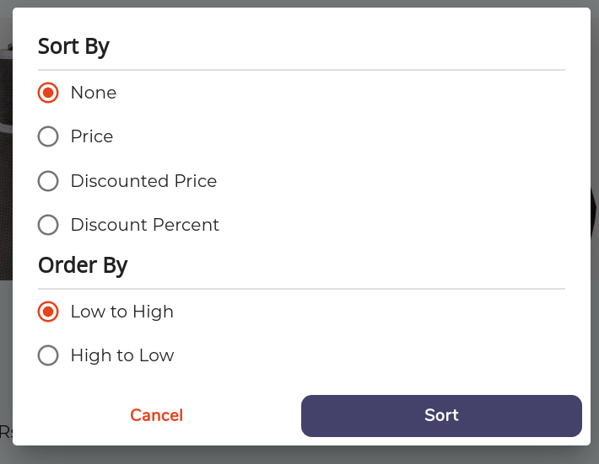
This page comes with powerful sorting and filtering techniques.
As you click on sort you will get the popup asking for you to select the sort by option and sorting order you want.

Slide 36
Product Overview Page
If you click on any product you are redirected to product overview screen.
This page shows you all the details of the products like material its made of, compartment and all other details.
This details are product specific
You can also view images of products from various angles.
We have also made this page mobile responsive. So it doesn’t matter on which device you are you still get seamless experience.

Slide 37
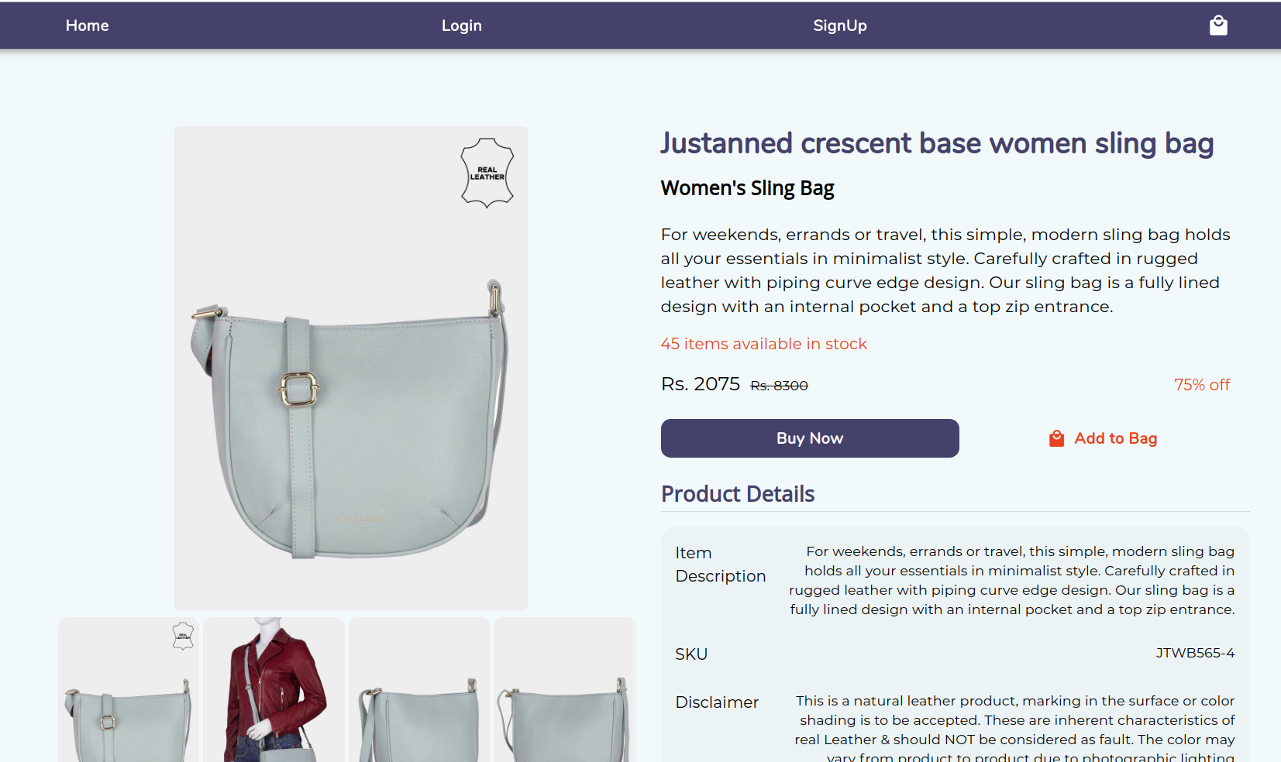

Slide 38
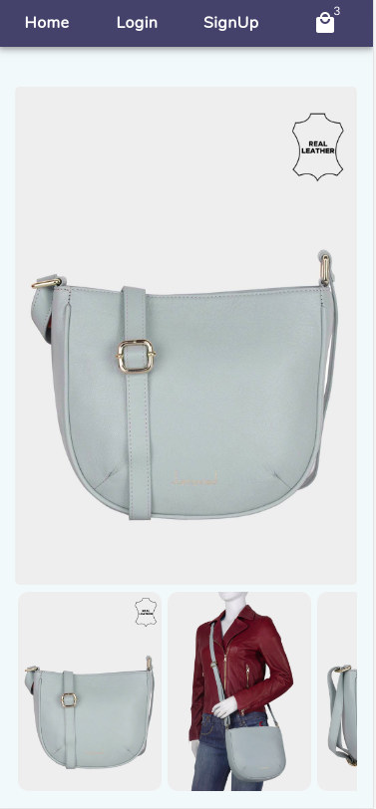
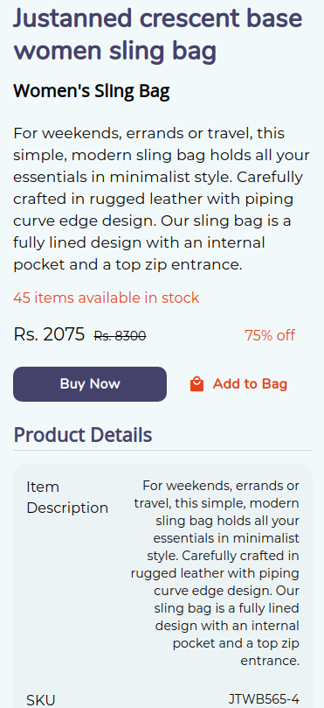
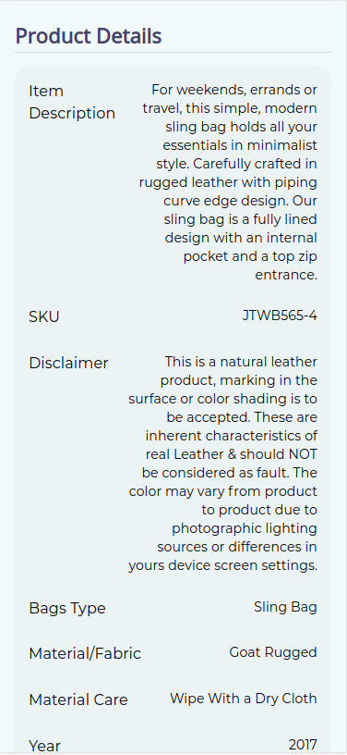

Slide 39
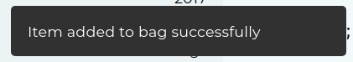
Snackbar
We added a little snackbar to keep the overall experience interactive.
Suppose if you add product to cart you get that little snackbar from left bottom of screen saying item added to cart successfully.
It also shows you errors if you do something that you are not supposed to do

Slide 40
Bag
The bag show you all the products you added to the bag.
There you can change the quantity of products or remove the product from the bag.
We also included the clear bag option in bag so you can remove all them items from the bag directly in one go.
It shows you the total summary your items in bag like total amount, the total money you are saving and also the amount you have to pay.
And also an option Proceed to checkout

Slide 41
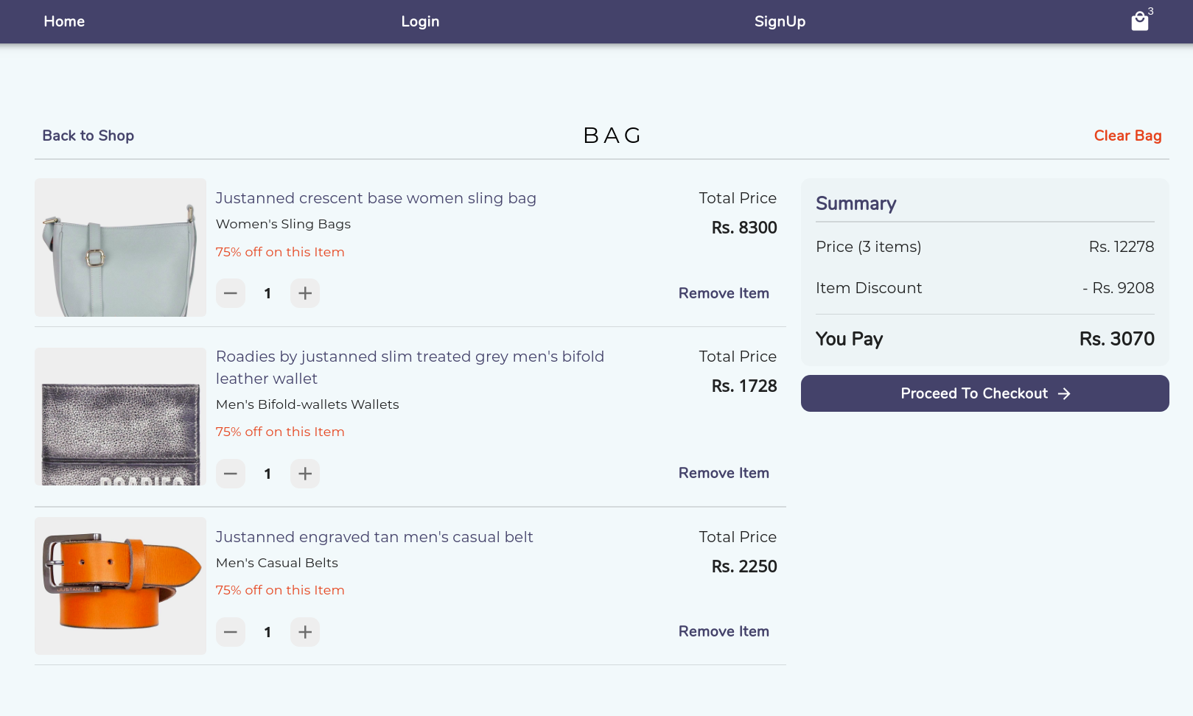

Slide 42
Checkout
The checkout is 3 step process.
In 1st you get the summary of what you are going to buy.
In 2nd you select, add address where you want it to be delivered and also you can delete your saved address.
In 3rd you get payment options like Cash on Delivery, Debit Card, Credit Card, UPI or net banking.
As your payment is successfull your order is placed

Slide 43
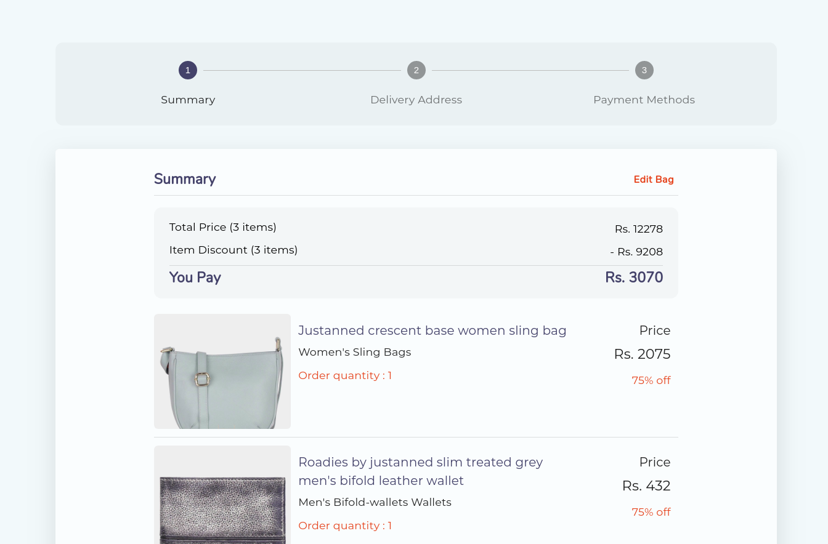
First Step

Slide 44
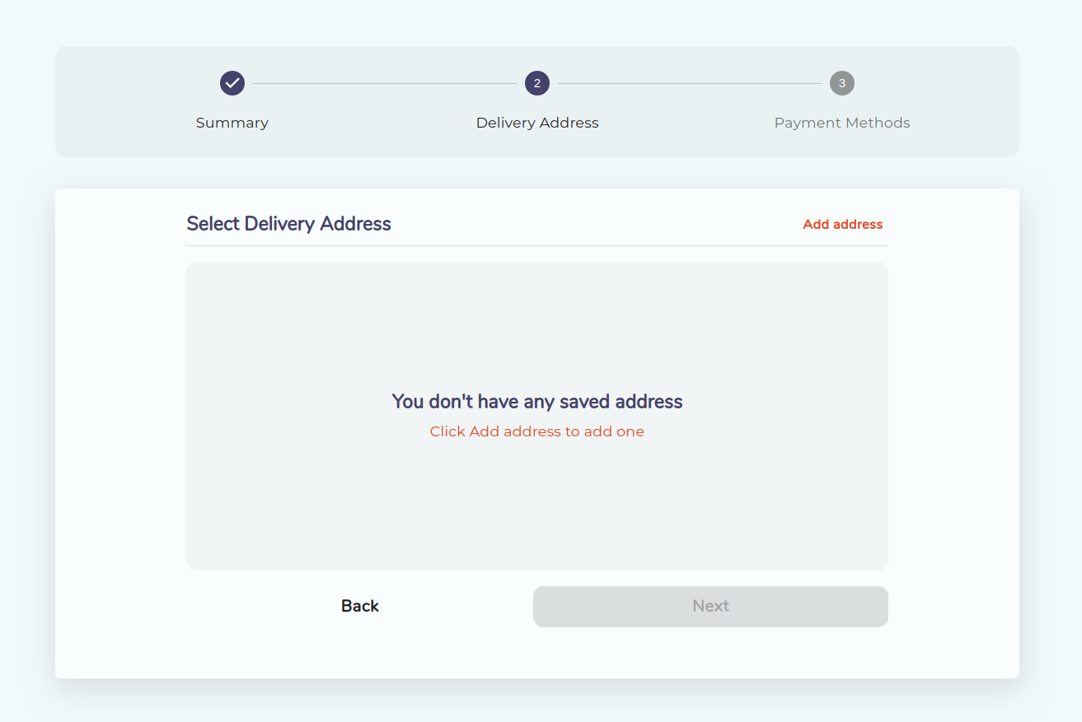
Second Step

Slide 45
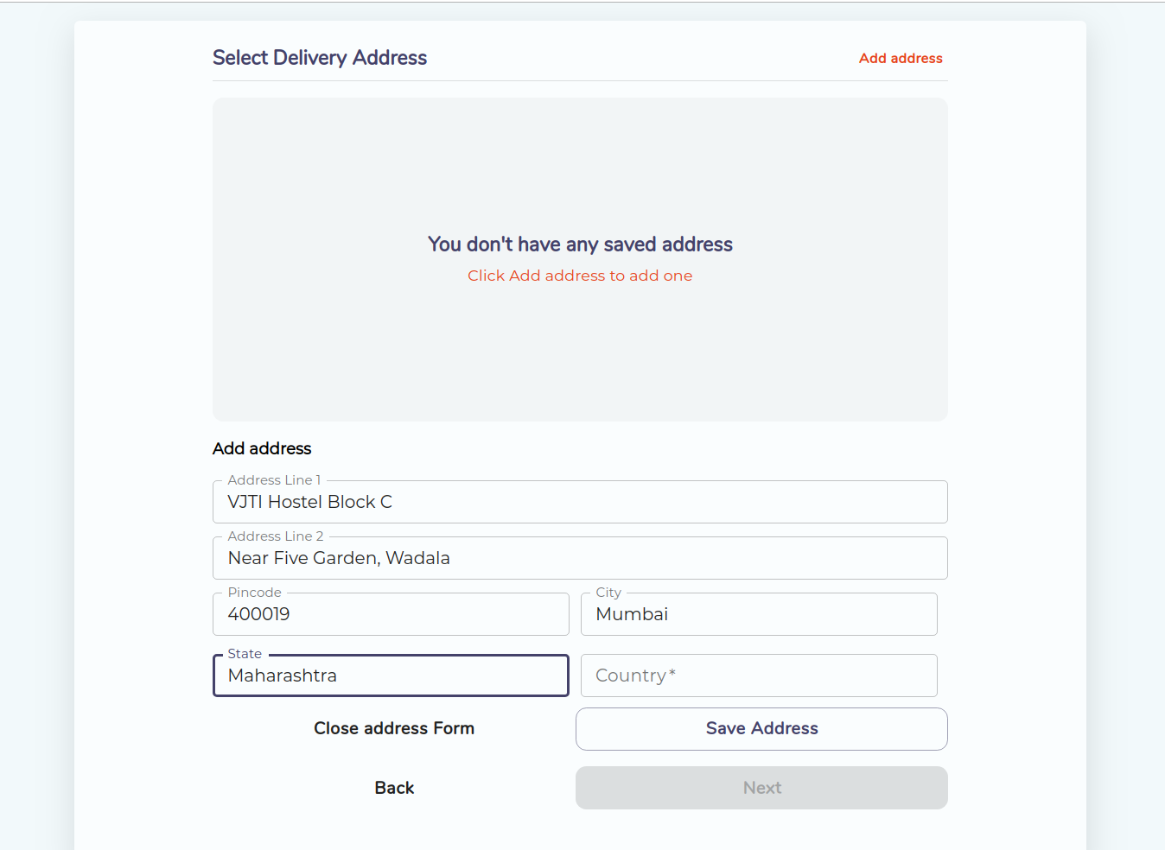
Second Step - Adding Address

Slide 46
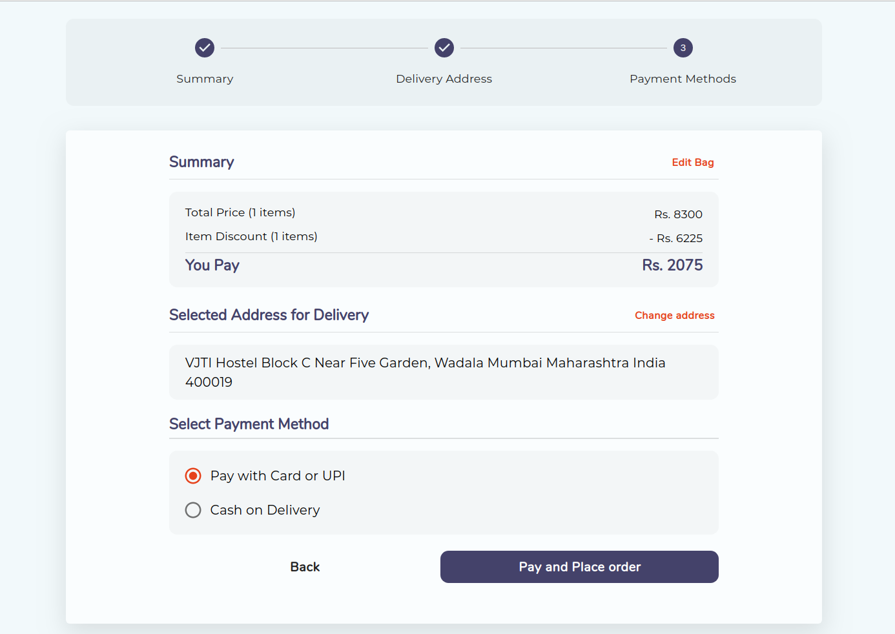
Third Step - Choosing Option

Slide 47
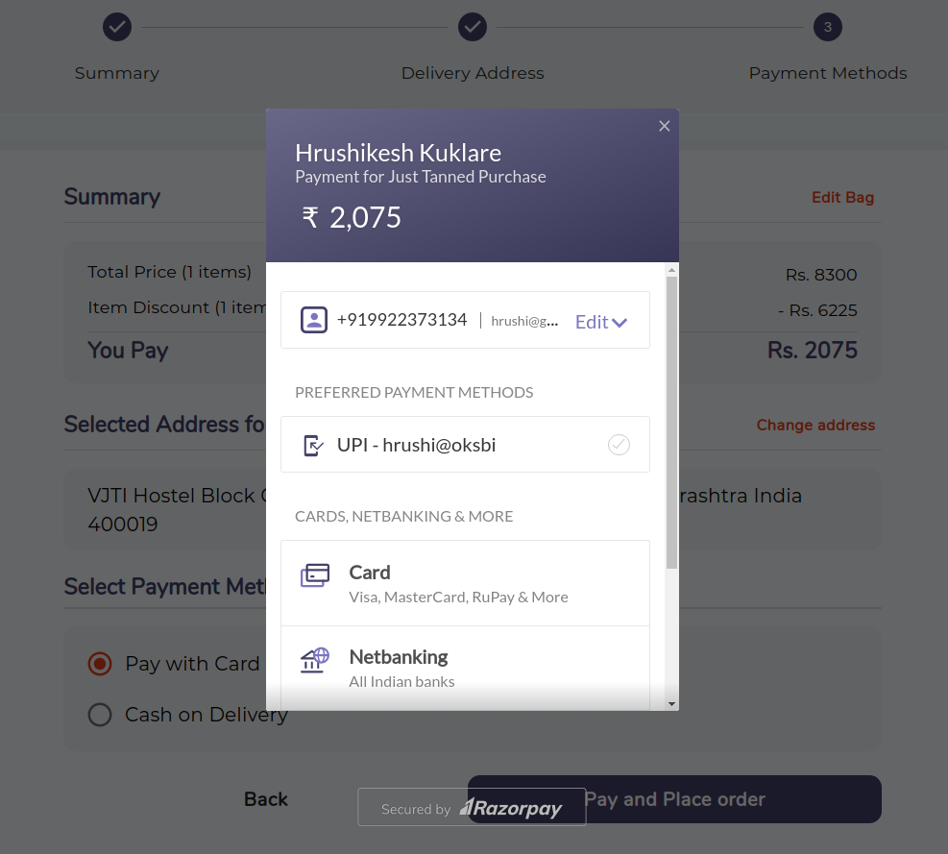
Third Step - Making Payment

Slide 48
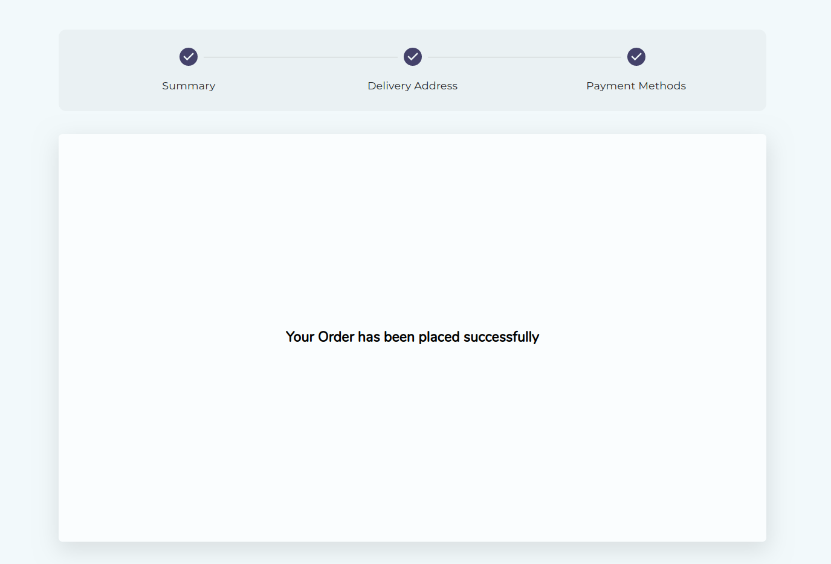
Order Placed Screen

Slide 49
Website is hosted at
https://leather-b123b.firebaseapp.com/

Slide 50
References
https://www.postgresqltutorial.com
https://reactjs.org/
https://material-ui.com
https://nodejs.org/en/docs/
https://stackoverflow.com/

Slide 51
Thank You

